Slide 1
Class 1 Introduction
Health Economics 339

Slide 2
Instructor
Vinish Shrestha
Health Economics
Originally from Nepal
Soccer, Guitars, Hike/Trek

Slide 3
Classroom Introduction
Pick a person you don’t know and introduce yourself. Soon I will ask you to introduce your new mate to the class. About, hobbies, what you did over break.

Slide 4
Administrative Matters
Office Hours:
  12-1 pm on Tuesdays and Thursdays
  Or by appointment
Syllabus
  Posted on blackboard
  Go Over the Syllabus

Slide 5
Teaching Approach
1. Use of PowerPoint and the whiteboard
  All lecture notes are produced in powerpoint
  Print and go over before class
  Take notes on the powerpoint slides (paper version)
  Use of laptops/note pads disallowed
2. Interactive and discussion based
3. Relate the course materials with real life events

Slide 6
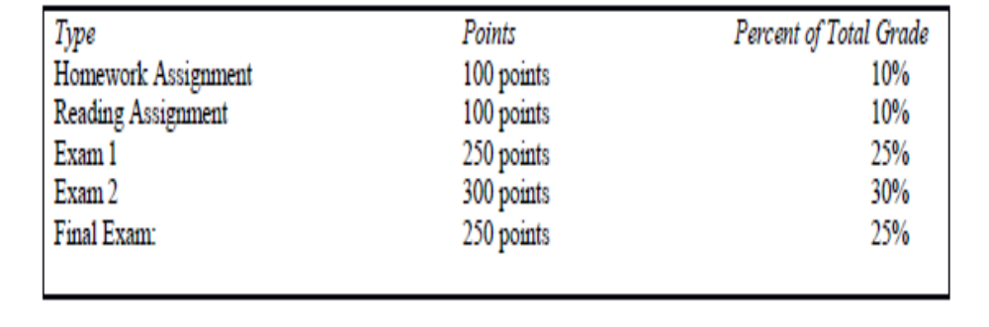
Grade Breakdown

Slide 7
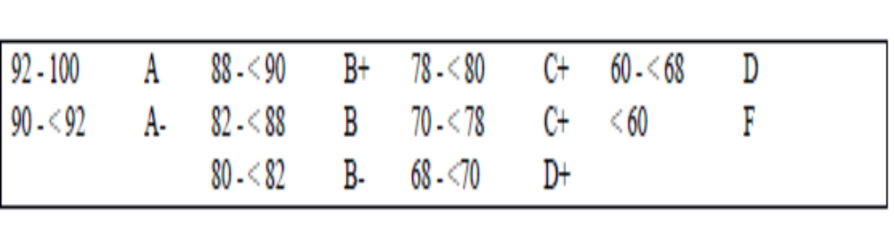
Grade Breakdown

Slide 8
Expectations
Please attend classes
No cell phone, I-pad policy
  I take this matter very seriously. When you are using a cell phone in class, you create negative externality! If you have to use cell phone, kindly move away from the classroom.
3. Read before hand and be read to contribute in class
  Will have assignments based on lectures and textbooks
Hard work pays off

Slide 9
To keep us on track ….
Use of a Road Map
Lecture Guides
Important Due Dates (given in Table 3 of syllabus)
Go over the Syllabus

Slide 10
Econ 339 - Roadmap
Focus Midterm 1
Focus Midterm 2
Focus Final
Review of Microeconomics
Demand for Insurance
Chapter 7
Uncertainty
Risk aversion
The health policy conundrum
Chapter 15
Capital stock K
Intro (from my slides)
Adverse selection
Chapters 8 and 9
Akerlof’s market for lemons
Rothschild-Stiglitz model
The Beveridge Model
Chapter 16
Demand for health care
Chapter 2
The American Model
Chapter 18 and slides provided (ACA)
The Grossman model
Chapter 3
Adverse Selection in
Real market
Chapter 10
Socioeconomic
Disparities
Chapter 4
Special Topics (if time allows)
Chapter 20
Slides provided
Moral hazard
Chapter 11

